Slide 1


Pacific Cascade MS PTSA
Membership Meeting
May 30, 2019

Slide 2

Agenda
Secretary’s Report
School Leadership Report
Officers’ and Directors’ Reports
Approval of Standing Rules Changes
Approval of 2019-2020 Budget
Preview of 2019-2020 PTSA Calendar
Parent Education: School Librarian Bethany Steirer’s Library Update and Summer Reading Recommendations

Slide 3
Secretary’s Report
Approval of minutes from March 21, 2019, membership meeting

Slide 4
School Leadership Report
Report from Principal Dana Bailey

Slide 5
Presidents’ Report
2019 WSPTA Convention, April 26-28
Joana Figueiredo attended as our Voting Delegate
Highlights:
  2019-21 WSPTA Board of Directors was elected and installed
  Seven amendments to the WSPTA Uniform Bylaws were adopted, including:
    Option to use electronic voting. Local PTSAs also can adjust their bylaws to also allow this type of vote.
    PTA membership requirement for Nominating Committee member and Officer candidate standardized to 15 days for both.
    Clarified that a Nominating Committee may recommend a slate where not all the positions are filled if no suitable candidates were found.

Slide 6
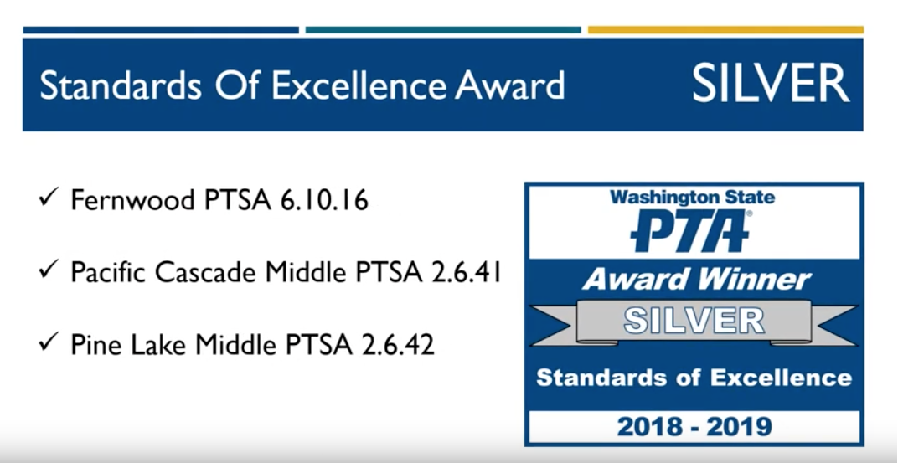
Presidents’ Report
2019 WSPTA Convention, April 26-28
Highlights (con’t):
  Awards of Excellence results were announced – PCMS PTSA received Silver Level Standards of Excellence award!

Slide 7
Presidents’ Report
From Council:
Summer move in dates set for new ISD Admin building – old building will be used to house “ISD Early Learning Center,” a new, tuition-based preschool program starting in the Fall.
ISD is piloting a partnership with YMCA to offer weekend enrichment opportunities to 13 at-risk students at Beaver Lake M.S.; if successful, the program will be expanded to other middle schools.

Slide 8
Presidents’ Report
“Strengths and Difficulties Questionnaire” was given again this Spring. The survey provides insight about individual student emotional and behavioral functioning. Schools contact the parents of students whose scores indicate high-internalized stress.
Save the Date: Tuesday, August 27. Issaquah High PTSA is hosting a “New to IHS Night” for incoming 9th graders and 10-12th grade transfers. Doors open at 6:30pm; program runs from 7-8:30pm.

Slide 9
Treasurer’s Report
March/April Highlights:
Income primarily from Membership & Corporate Matching
Expenses paid include:
  Membership Fees
  Awards and Recognition
  Curriculum Enrichment Grants approved at March Membership Meeting
Bank statements were reviewed by a non-signer
There have been no claims against our insurance
Renewed our charitable status with WA State
Year end Financial Review is scheduled in July
Next year’s bank signers will be Natalie Edmonds, Eloisa Tang, and Lisa Small

Slide 10
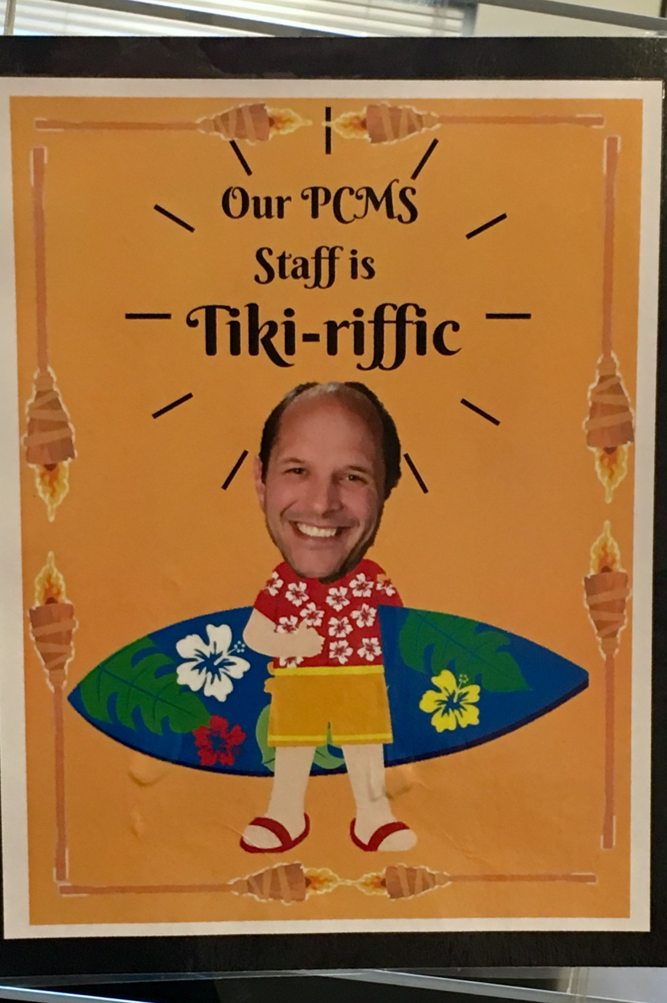
Programs
Staff Appreciation Week (May 6 – 10)
          Theme: “Our Staff is Tiki-riffic”
          PTSA worked with Ms. Butson and the Leadership class to decorate and clean the staff lounge, hang posters throughout the school, and show the PCMS staff how much they are appreciated every day!
          PTSA provided breakfasts, lunches, and treats to the staff during the week
          Thank you to our families for their generous donations of food and gift cards!

Slide 11

Programs

Slide 12
ASB/Lynx Life
Upcoming volunteer opportunities:
Locker Cleanouts – Dates TBA
There will be two locker cleanouts before Summer Break. The first clean out is the standard end-of-Tri cleanout. The second one will be approximately a week before school is out, when everything must be emptied out of the lockers.
All School Social – June 27
Watch the eNews for information regarding donation and volunteer needs!

Slide 13
Volunteers
Upcoming volunteer opportunities:
8th Grade Party and Promotion – June 21 and 24
We have already started to request donations for raffles, as well as volunteers to help work and chaperone the party. Click these links to sign up and/or donate:
Party: https://docs.google.com/spreadsheets/d/1njeD3fjDJkqRWvS96mDgEF294CaetGW6JyqHA4_FLg4/edit#gid=0
Promotion Reception: https://docs.google.com/spreadsheets/d/1h-SjAS2hlNnARROUHY42tu4_-QfAb3-QymoPvwMbAq4/edit?usp=sharing
Lynx Days – August 20 & 21
We need parents to help with student pictures, schedules, PE clothes, books, lockers, and much more! Please mark your calendar, and watch the eNews for volunteer sign ups.

Slide 14
Volunteers
Open PTSA Positions 2019-2020

Slide 15

Issaquah Schools Foundation
Dining for Kids
  Wednesday, June 5, at
  Levitate Gastropub (Front Street)
Tools4School
  You can donate a school supply kit online at: https://supplyallkids.com/#/donate/isf
  Families who need assistance can register at: http://isfdn.org/tools-for-school-registration/ to receive a backpack with supplies.
  Backpacks and supplies will be distributed on Monday, August 12, 2019, from 3:00 - 8:00 pm at Clark Elementary.

Slide 16
New Business
Approval of Standing Rule Changes
Approval of 2019-2020 Preliminary Budget
Preview of 2019-2020 Calendar

Slide 17
Standing Rules
Changes to PTSA Standing Rules:
Amend Section 6. Charitable Organization.
  The Treasurer is responsible for filing the Annual Charitable Solicitations renewal on or before November 15 May 31 each year.
Add New Section 34. Login and Password Policy
  This PTSA shall maintain policies for online logins and passwords. This policy shall be reviewed and approved yearly by the Board of Directors. This policy shall reside with the Treasurer.
Renumber all subsequent Sections 35-39 (current 34-38).

Slide 18
2019-20 Proposed Budget
Changes made are primarily from:
Donations decrease
Curriculum Enrichment Grants
Added Cultural Fair
Changed names of some of the line items as discussed during Budget Committee meeting

Slide 19
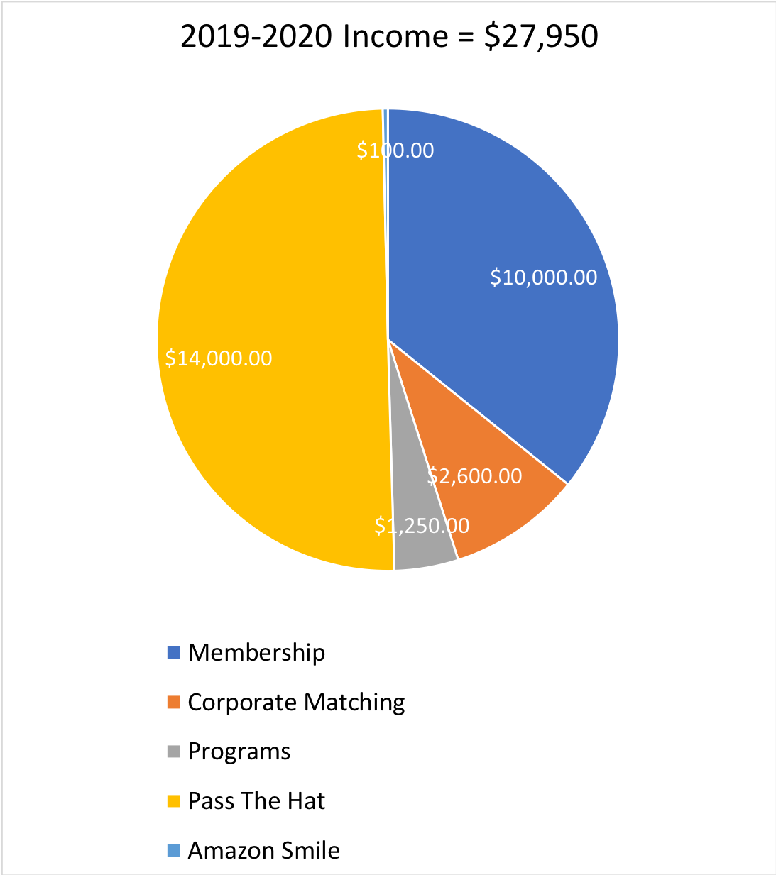
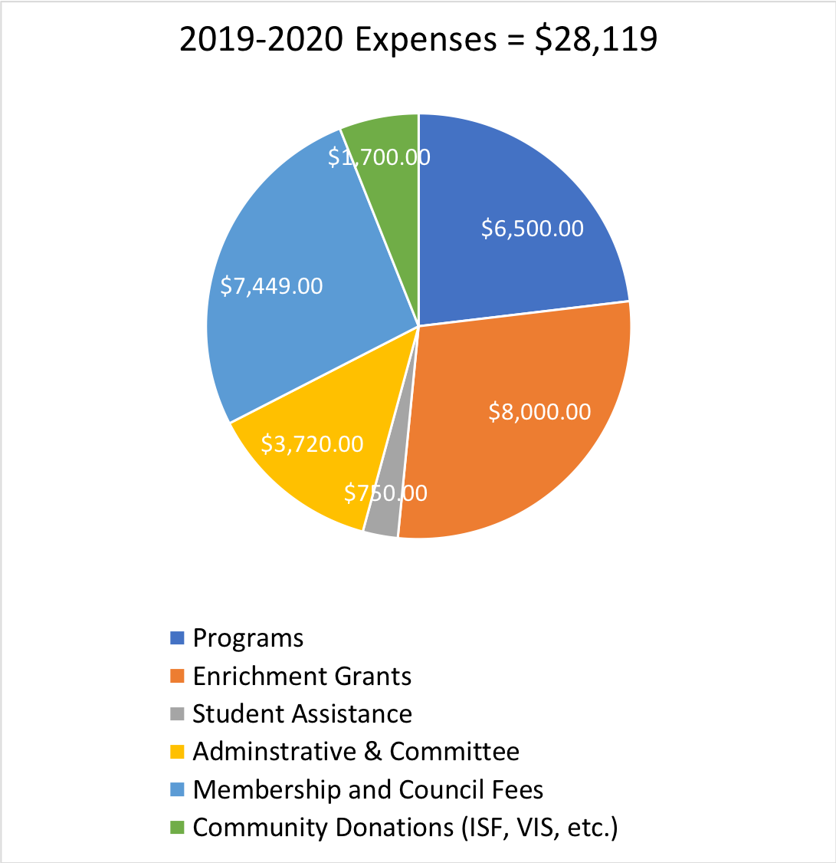
2019-20 Proposed Budget

Slide 20
2019-20 Calendar Preview
August |  | February
8-15: BTSCI Online 20-21: Lynx Days |  | TBA: WSPTA Advocacy Week TBA: Levy Vote
September |  | March
3: Staff Appreciation Lunch 26: Fall Social 26: Membership Meeting |  | 20: Membership Meeting 21: Staff Appreciation Lunch
October |  | April
26-27: WSPTA Legislative Assembly 28: Reflections Entries Due |  | TBA: Cultural Fair
November |  | May
13: Reflections Reception 21: Membership Meeting |  | 4-8: Staff Appreciation Week 15-17: WSPTA Convention
December |  | June
3: Holiday Gift Barn 6: Staff Appreciation Lunch |  | 4: Membership Meeting
January
16: Membership Meeting

Slide 21
Parent Education
Library Update &
Summer Reading Recommendations
by
Bethany Steirer

Slide 22
Adjourned.
Thank you for coming!
See you in the Fall!!

